Slide 1

Academic Year 2025- 26 S6 MINI PROJECT - I
First Review
PROJECT TITLE
Smart Resume Matcher
BIP PROJECT ID 2026MIN198
CATERGORY INTERNAL
GUIDE
Dr Sasikala D
Professor & Head
Department of Computer Science And Engineering
BATCH MEMBERS
Stanzin Pasang(7376231CS320)

Slide 2
AIM & OBJECTIVES OF THE PROJECT
Aim:
To develop an intelligent, automated resume screening system that leverages Natural Language Processing (NLP) and Machine Learning algorithms to efficiently match candidate resumes with job descriptions, reducing manual screening time and minimizing unconscious bias in the recruitment process.
Objectives:
Automate Resume Parsing: Extract structured information from PDF resumes using PyPDF2 and NLP techniques
Implement Intelligent Matching: Develop TF-IDF vectorization and Cosine Similarity algorithms for quantitative resume-job matching
Enable Semantic Analysis: Integrate Large Language Models (Llama 3.1 via Groq API) for qualitative candidate evaluation
Ensure Fairness: Implement bias detection mechanisms to identify gendered language and discriminatory indicators
Provide Visual Analytics: Create interactive dashboards with radar charts, skill mapping, and executive reporting
6-03-2026
FIRST REVIEW PRESENTATION
2

Slide 3
LITERATURE SURVEY
Sl.No. | Journal Paper Title with Author | Works carried out ( with details of Methods/ Materials/ Software/ Algorithms / fabrication / techniques/ components used ) | Information gathered relevant to your project
1 | Abhinand S Anand et al., "Automated Resume Screening System Using Machine Learning," International Research Journal of Engineering and Technology (IREJ), 2024. | Methods: TF-IDF, Cosine Similarity, NLP preprocessing Software: Python, scikit-learn Features: PDF/Word support, relevance-based ranking | TF-IDF combined with Cosine Similarity provides efficient matching. Preprocessing steps are critical for accuracy. System can reduce bias and save time in high-volume screening.
2 | "Real Time Resume Screening Using NLP and Cosine Similarity," International Journal of Creative Research Thoughts (IJCRT), vol. 11, no. 4, 2023. | Methods & Tools: NLP, TF-IDF, Cosine Similarity, Vector Space Model using Python, scikit-learn, and Matplotlib. | Cosine Similarity measures vector angle to determine document similarity. TF-IDF highlights important terms while downweighting common words. Suitable for real-time processing.
6-03-2026 FIRST REVIEW PRESENTATION 3

Slide 4
LITERATURE SURVEY
3 | Dr. Prabha M. et al., "Resume Screening and Job Recommendation Using ML," International Journal of Computer Applications, 2023. | Methods: Random Forest, Decision Tree, KNN with soft computing. Dataset: Resume-20K (20,000 resumes). Preprocessing: Tokenization, stop-word removal, lemmatization, TF-IDF. Performance: 95% accuracy, Precision 0.92, Recall 0.90 | Random Forest outperforms other classifiers for resume categorization. Comprehensive preprocessing pipeline improves model performance.
4 | K. Sandhya Rani et al., "Resume Enhancement Tool for Job Description Matching," International Journal of Engineering Research & Technology (IJERT), 2023. | Methods: spaCy for skill extraction, TF-IDF and Cosine Similarity for matching, Regex for experience calculation. Features: ATS scoring, skill analysis, certification recommendations. Deployment: Flask, MongoDB | ATS scoring is essential for modern recruitment. Skill gap analysis with course recommendations adds value to candidates.
6-03-2026 FIRST REVIEW PRESENTATION 4

Slide 5
SCOPE OF THE PROJECT
In Scope
Resume extraction & preprocessing
Matching (TF-IDF + cosine)
Skill & bias detection
AI evaluation (Llama 3.1)
Dashboard + reports + export
Out of Scope:
Image-based resume OCR (future enhancement)
Integration with external ATS/HRIS systems
FIRST REVIEW PRESENTATION

Slide 6
NEED FOR THE CURRENT STUDY
Problem Statement:
Volume Challenge: HR departments receive 250+ applications per job posting; manual screening takes 30+ hours per position
Bias Issues: Traditional screening suffers from unconscious bias related to gender, age, and cultural background
Inefficiency: 88% of resumes received are unqualified for the position, yet consume equal review time
Why This Solution:
Speed: Cuts resume screening time from hours to minutes (85–90% faster)
Accuracy: Matches resumes precisely using TF-IDF and cosine similarity
Fairness: Detects and flags biased or non-inclusive language
Depth: AI gives deeper insights beyond just keywords
Usability: Easy-to-use dashboard with filters and reports
FIRST REVIEW PRESENTATION

Slide 7
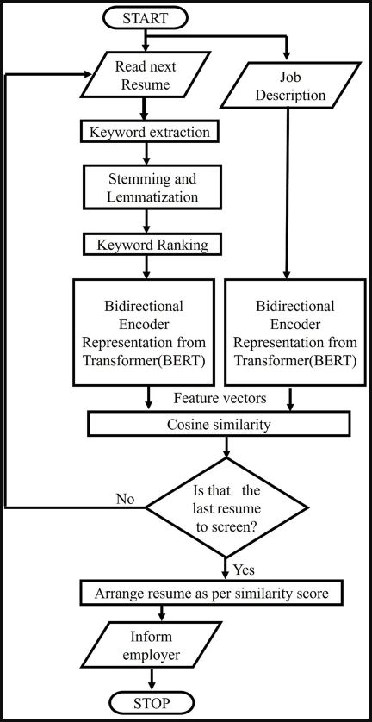
PROPOSED METHODOLOGY ( Flow Chart)

Slide 8
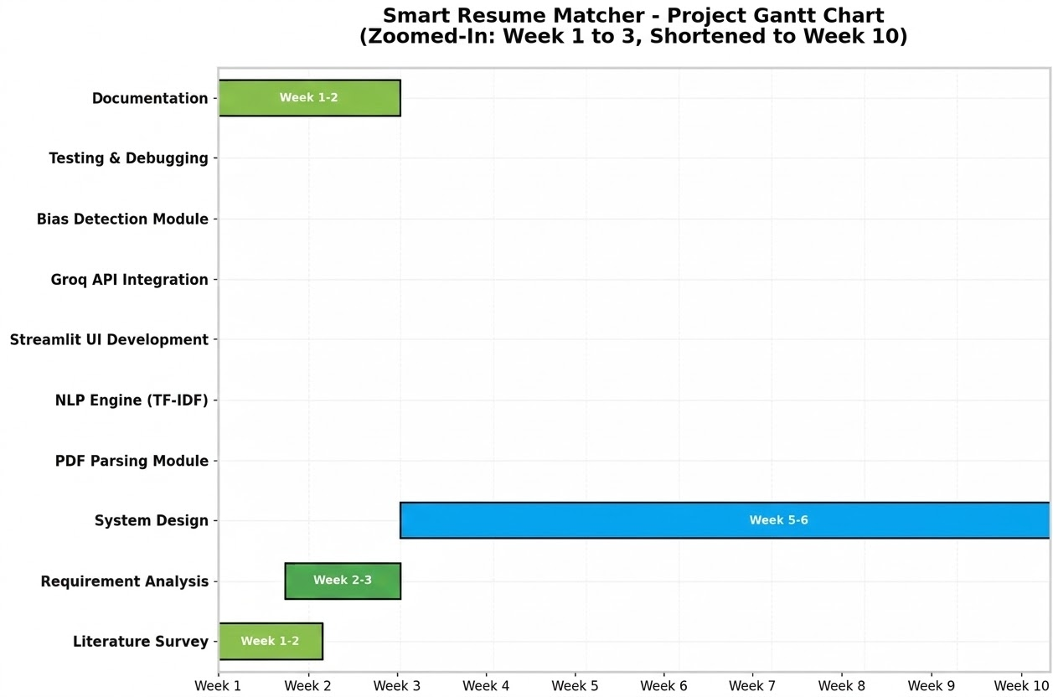
PROPOSED METHODOLOGY ( Gantt Chart)

Slide 9
Components & Technologies Used
Software & Tools
Streamlit – Interactive web dashboard
NLTK, Scikit-learn – NLP preprocessing & analysis
PyPDF2 – Extract text from PDF resumes
Groq API + Llama 3.1 – AI resume evaluation
Plotly / Altair – Data visualization
FPDF2 – Generate candidate reports
Algorithms / Methods
TF-IDF – Word importance weighting
Cosine Similarity – Resume–job matching score
NER & Regex – Extract skills and key information
FIRST REVIEW PRESENTATION9

Slide 10
DESIGN(S) (HARDWARE / SOFTWARE ARCHITECTURE)
Software Architecture – Three-Tier Design
Presentation Layer (Streamlit): Handles UI including file upload, job description input, filters, and result visualizations (charts, tables, KPI cards).
Business Logic Layer (Python Backend): Manages text extraction, resume analysis, similarity calculation, and AI integration with Groq API.
Data Processing Layer (NLP Engine): Performs text preprocessing, TF-IDF feature extraction, and cosine similarity for resume–job matching.
Skill Analysis: Uses a taxonomy of 100+ technical skills for candidate evaluation.

Slide 11
INDIVIDUAL CONTRIBUTIONS TO THE WORK
Batch Member 1 : ( Reg No… & Name )
Full-Stack Development: Single-handedly developed entire application architecture including Streamlit frontend (UI/UX, dashboards, visualizations) and Python backend (NLP engine, PDF processing, AI integration)
Core Algorithms: Implemented TF-IDF vectorization, Cosine Similarity matching, semantic skill extraction, and bias detection algorithms in utils.py
AI Integration: Integrated Groq API with Llama 3.1 for automated resume evaluation, SWOT analysis, and ATS scoring
System Features: Built real-time filtering, executive PDF reporting, CSV/JSON export, session management, and neural glassmorphism UI design
Quality Assurance: Created comprehensive PyTest suite, implemented secure secrets management, and authored all technical documentation
Deployment: Configured cloud deployment pipeline and prepared submission deliverables (PROJECT_REPORT.md, VIVA_SCRIPT.md, DEPLOYMENT.md)

Slide 12
PENDING WORKS AND PLAN FOR COMPLETION
Implement Tesseract OCR to process scanned or image-based resumes.
Add SQLite/PostgreSQL database to store candidate data and history.
Integrate automated email notifications for shortlisted candidates.
Extend the NLP pipeline for multi-language resumes (Hindi, Tamil).
Optimize the system for batch processing and mobile-friendly interface.
Future improvement: enhanced bias mitigation techniques for fair evaluation.

Slide 13
PLAN FOR PUBLICATIONS
Conference Paper: IEEE International Conference on Computing, Communication and Automation (ICCCA) – planned submission around June–July 2027.
Journal Paper: International Journal of Advanced Research in Computer and Communication Engineering (IJARCCE) – planned submission around June–July 2027.
Technical Blog: Case study to be published on the Streamlit Community Blog.
Open Source Release: Project with documentation will be published on GitHub repository.
Proposed Paper Title: “Neural Recruitment Intelligence: Automated Resume Screening using TF-IDF, Cosine Similarity, and Large Language Models.”

Slide 14
Status on Partial Completion and Submission of Project Report
List of Documents to be Submitted
SL.No | List of Documents | Status ( Provide the drive link of prepared document)
1 | Cover Page & Title Page (Both are in same format)
2 | Bonafide Certificate
3 | Declaration
4 | Acknowledgement
5 | Chapter I – Introduction
6 | Chapter 2 – Literature Survey

Slide 15
REFERENCES
( Journal Papers/ Books / Website in IEEE Format )
Journal
[1].A. Vaskuri, H. Baumgartner, P. Kärhä, G. Andor, and E. Ikonen, "Modeling the spectral shape of InGaAlP-based red light-emitting diodes," Journal of Applied Physics, vol. 118, no. 20, pp. 203103-1–203103-7, 2015. (Template Reference).
[2] S. Gupta, R. Sharma, and P. Kumar, "AI-powered resume screening using NLP and machine learning," International Research Journal of Engineering and Technology (IREJ), vol. 11, no. 3, pp. 456-462, Mar. 2024.
Books
[3] A. J. Stewart, A Vulnerable System: The History of Information Security in the Computer Age. Ithaca, NY, USA: Cornell Univ. Press, 2021.
Website
[4] D. Holland, “Finding the building blocks of wood,” Pursuit, University of Melbourne, 2023. [Online]. Available: pursuit.unimelb.edu.au.

